Slide 1

Programming with Python
Chapter 4

Slide 2
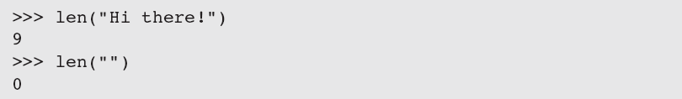
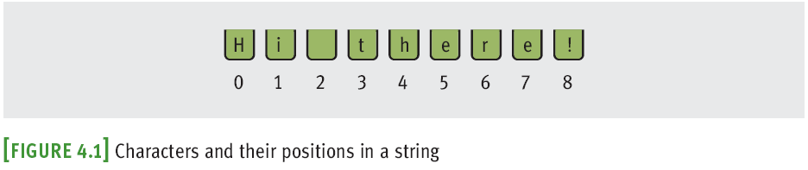
The Structure of Strings
An integer can’t be factored into more primitive parts
A string is an immutable data structure
Data structure: Consists of smaller pieces of data
String’s length: Number of characters it contains (0+)

Slide 3
The Subscript Operator
The form of the subscript operator is:
index is usually in range [0,length of string – 1];
can be negative

Slide 4
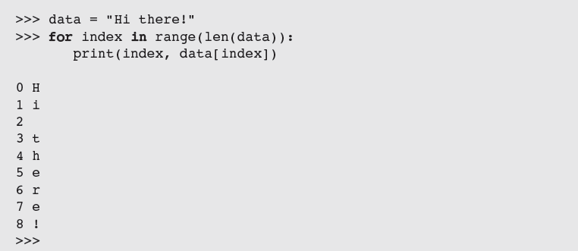
The Subscript Operator
Subscript operator is useful when you want to use the positions as well as the characters in a string
Use a count-controlled loop

Slide 5
Slicing for Substrings
Python’s subscript operator can be used to obtain a substring through a process called slicing
Place a colon (:) in the subscript; an integer value can appear on either side of the colon

Slide 6
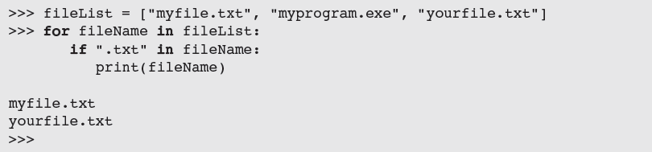
Testing for a Substring with the in Operator
When used with strings, the left operand of in is a target substring and the right operand is the string to be searched
Returns True if target string is somewhere in search string, or False otherwise

Slide 7
Data Encryption
It is easy to observe data crossing a network, particularly in wireless networks
Attacker may use sniffing software
Data encryption can be used to protect information transmitted on networks
Many protocols have secure versions (e.g., HTTPS)
One or more keys are use to encrypt messages to produce cipher text, and to decrypt cipher text back to its original plain text form
Examples: Caesar cipher, block cipher

Slide 8
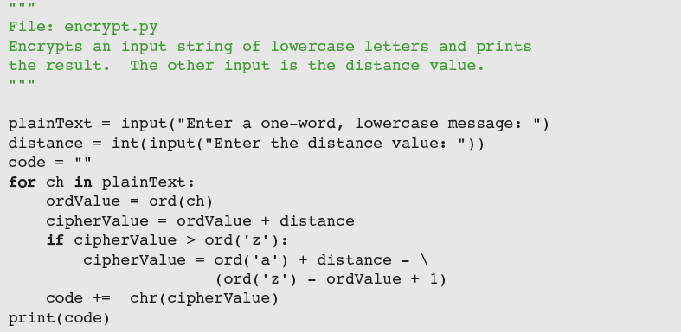
Data Encryption
Caesar cipher replaces each character in plain text with a character a given distance away

Slide 9
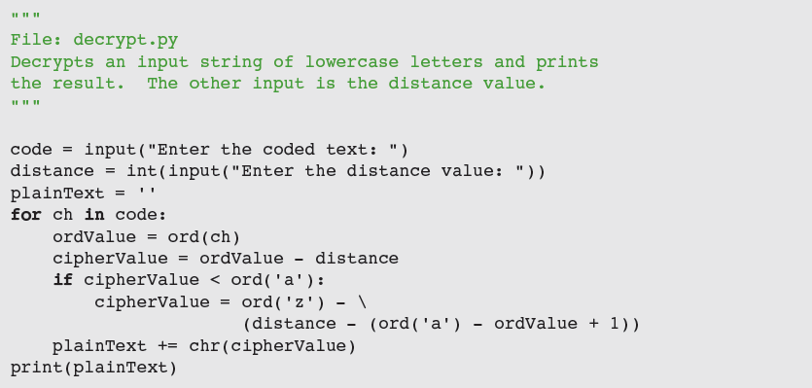
Data Encryption
To decrypt, use inverse method

Slide 10
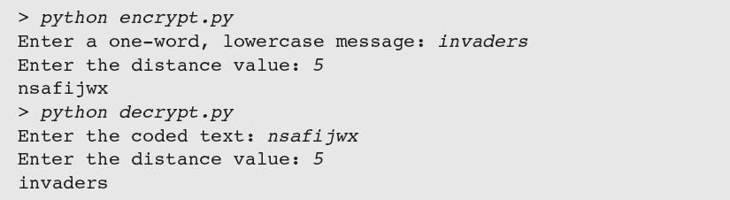
Data Encryption
Caesar cipher worked well in ancient times, but is easy to break using modern computers

Slide 11
Data Encryption
Block cipher
Uses plaintext character to compute two or more encrypted characters
Each encrypted character is computed using two or more plaintext characters
Uses an invertible matrix

Slide 12
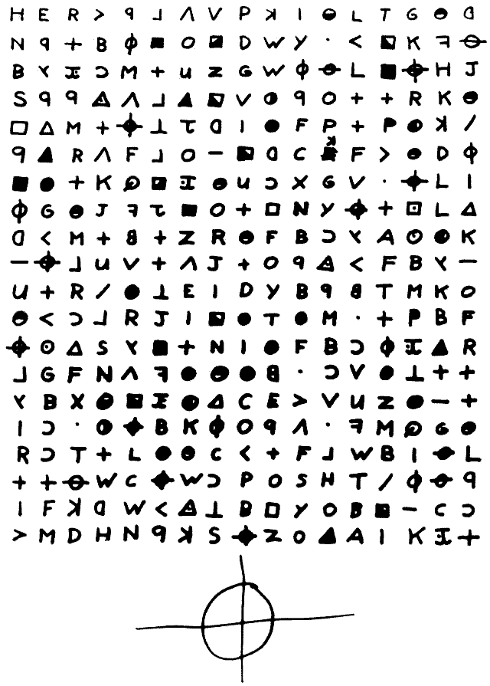
Other Ciphers…

Slide 13
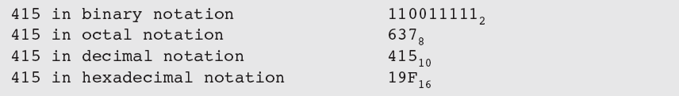
Strings and Number Systems
The digits used in each system are counted from 0 to n - 1, where n is the system’s base
To represent digits with values larger than 9₁₀, systems such as base 16 use letters
Example: A₁₆ represents the quantity 10₁₀, whereas 10₁₆ represents the quantity 16₁₀

Slide 14
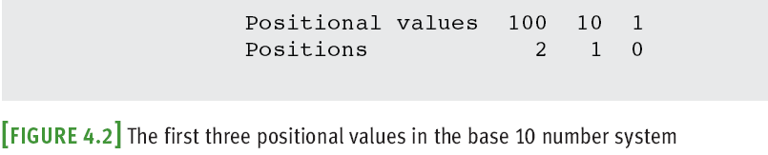
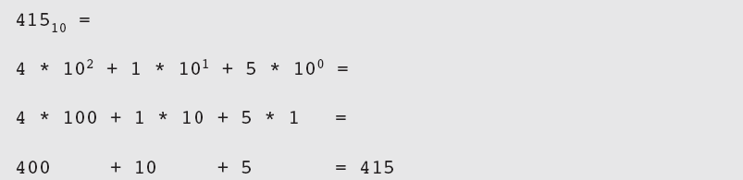
The Positional System for Representing Numbers
In positional notation, a digit has a positional value, determined by raising the base to the power specified by the position (base^{position})

Slide 15
Converting Binary to Decimal
Each digit or bit in binary number has positional value that is power of 2
We occasionally refer to a binary number as a string of bits or a bit string
To determine the integer quantity that a string of bits represents:

Slide 16
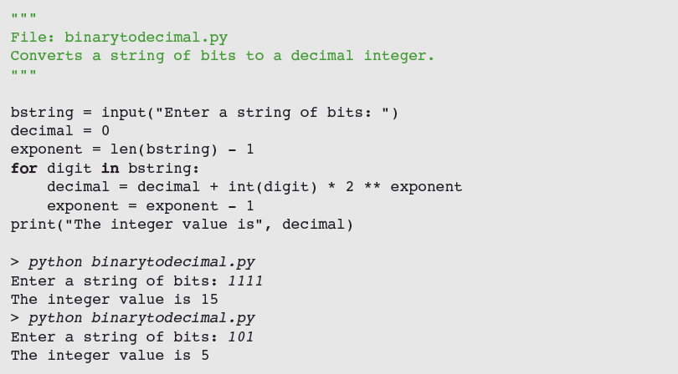
Converting Binary to Decimal

Slide 17
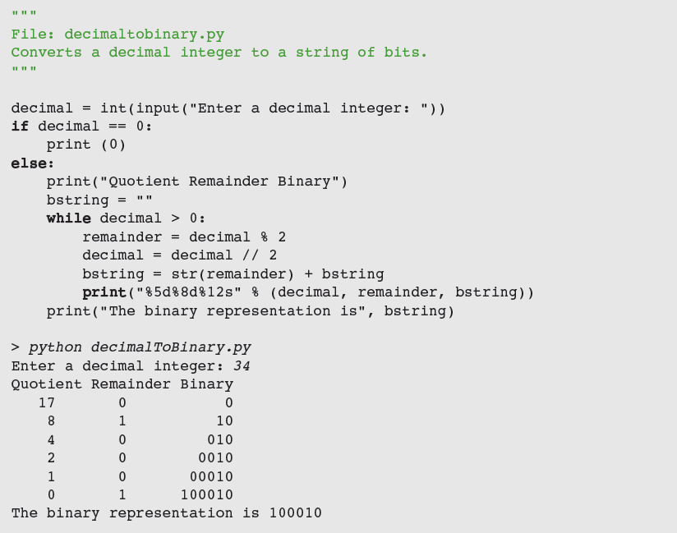
Converting Binary to Decimal

Slide 18
Conversion Shortcuts
Thus, a quick way to compute the decimal value of the number 11111₂ is 2⁵ - 1, or 31₁₀

Slide 19
Octal and Hexadecimal Numbers
To convert from octal to binary, start by assuming that each digit in the octal number represents three digits in the corresponding binary number
To convert binary to octal, you begin at the right and factor the bits into groups of three bits each

Slide 20
Octal and Hexadecimal Numbers
To convert from hex to binary, replace each hex digit with the corresponding 4-bit binary number
To convert from binary to hex, factor the bits into groups of 4 and look up the corresponding hex digits

Slide 21
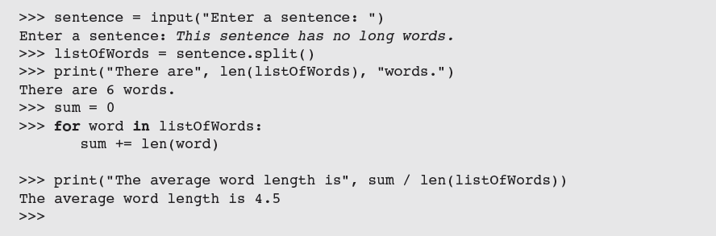
String Methods
Python includes a set of string operations called methods that make tasks like counting the words in a single sentence easy

Slide 22
String Methods
A method behaves like a function, but has a slightly different syntax
A method is always called with a given data value called an object
Methods can expect arguments and return values
A method knows about the internal state of the object with which it is called
In Python, all data values are objects

Slide 23
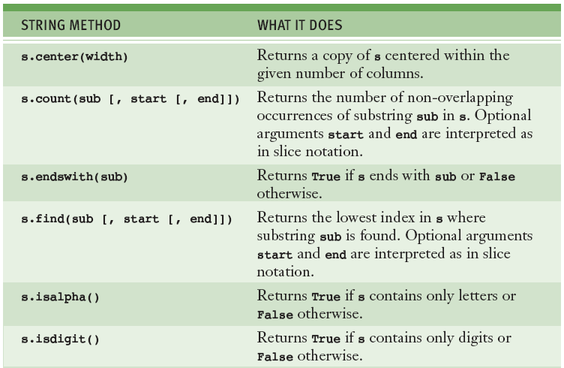
String Methods

Slide 24
String Methods

Slide 25
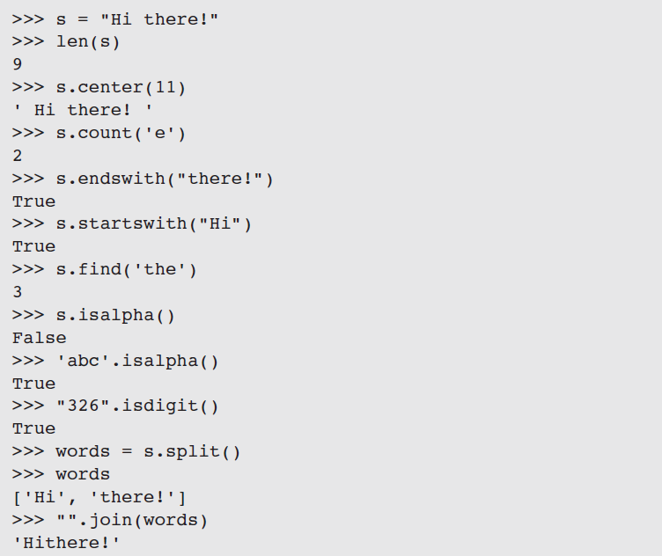
String Methods

Slide 26
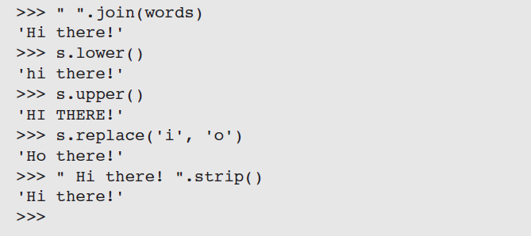
String Methods

Slide 27
String Methods
Example: extracting a filename’s extension
The subscript [-1] extracts the last element
Can be used to write a general expression for obtaining any filename’s extension, as follows:

Slide 28
Text Files
A text file is software object that stores data on permanent medium such as disk or CD
When compared to keyboard input from human user, the main advantages of taking input data from a file are:
The data set can be much larger
The data can be input much more quickly and with less chance of error
The data can be used repeatedly with the same program or with different programs

Slide 29
Text Files and Their Format
Using a text editor such as Notepad or TextEdit, you can create, view, and save data in a text file
All data output to or input from a text file must be strings

Slide 30
Writing Text to a File
Data can be output to a text file using a file object
To open a file for output:
If file does not exist, it is created
If it already exists, Python opens it; when data is written to the file and the file is closed, any data previously existing in the file are erased
Failure to close output file can result in data being lost

Slide 31
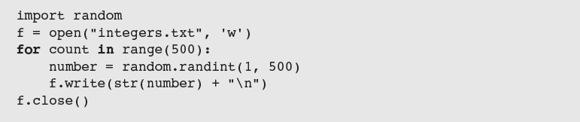
Writing Numbers to a File
The file method write expects a string as an argument
Other types of data must first be converted to strings before being written to output file (e.g., using str)

Slide 32
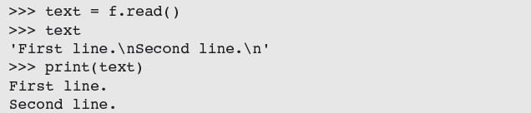
Reading Text from a File
You open a file for input in a manner similar to opening a file for output
If the path name is not accessible from the current working directory, Python raises an error
There are several ways to read data from a file
Example: the read method

Slide 33
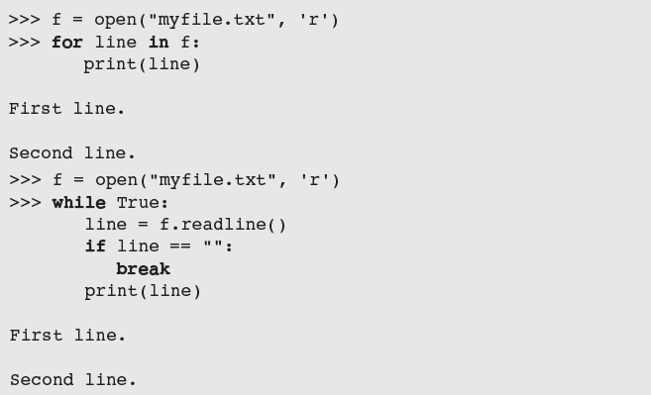
Reading Text from a File
After input is finished, read returns an empty string

Slide 34
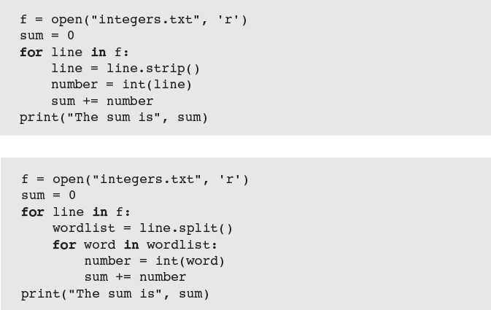
Reading Numbers from a File
What does each line of this code do?

Slide 35
Reading Numbers from a File

Slide 36
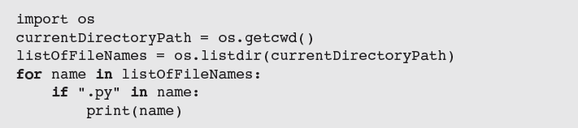
Accessing and Manipulating Files and Directories on Disk
When designing Python programs that interact with files, it’s a good idea to include error recovery
For example, before attempting to open a file for input, you should check to see if file exists
Function os.path.exists supports this checking
Example: To print all of the names of files in the current working directory with a .py extension:

Slide 37
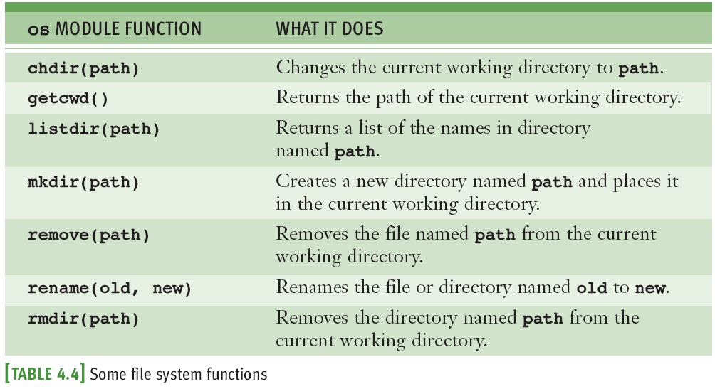
Accessing and Manipulating Files and Directories on Disk

Slide 38
Accessing and Manipulating Files and Directories on Disk

Slide 39
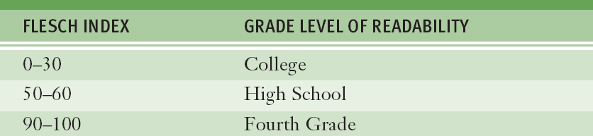
Case Study: Text Analysis
In 1949, Dr. Rudolf Flesch proposed a measure of text readability known as the Flesch Index
Index is based on the average number of syllables per word and the average number of words per sentence in a piece of text
Scores usually range from 0 to 100, and indicate readable prose for the following grade levels:

Slide 40
Case Study: Analysis
Input is the name of a text file
Outputs are the number of sentences, words, and syllables in the file, as well as the file’s Flesch index and grade-level equivalent

Slide 41
Case Study: Design

Slide 42
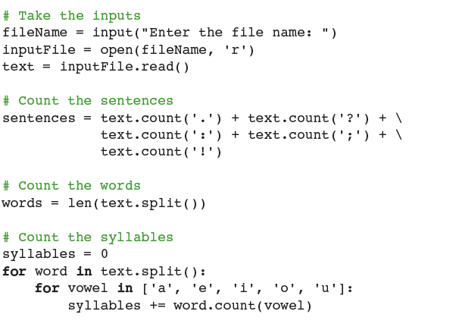
Case Study: Implementation (Coding)

Slide 43
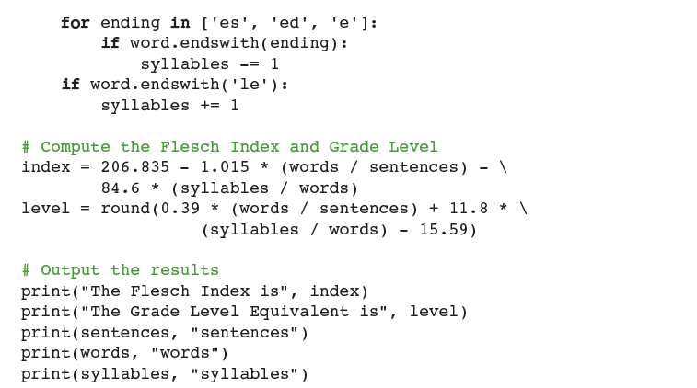
Case Study: Implementation (Coding)

Slide 44
Case Study: Testing
Bottom-up testing:
Each task is coded and tested before it is integrated into the overall program
After you have written code for one or two tasks, you can test them in a short script, called a driver

Slide 45
Summary
A string is a sequence of zero or more characters
Immutable data structure
[] used to access a character at a given position
Can also be used for slicing ([<start>:<end>])
in operator is used to detect the presence or absence of a substring in a string
Method: operation that is used with an object
The string type includes many useful methods for use with string objects
A text file is a software object that allows a program to transfer data to and from permanent storage
A file object is used to open a connection to a text file for input or output
Some useful methods: read, write, readline
for loop treats an input file as a sequence of lines
On each pass through the loop, the loop’s variable is bound to a line of text read from the file

